Slide 1


PISA, the OECD’s Programme for International Student Assessment
Fare clic per inserire testo
giulia bergonzoli
ettore Busani
Sebastian castellano
martina cornaro
lucia gregorini

Slide 2


DATASET
The PISA database contains the full set of responses from individual students, school principals and parents. These files will be of use to statisticians and professional researchers who would like to undertake their own analysis of the PISA data.

Slide 3
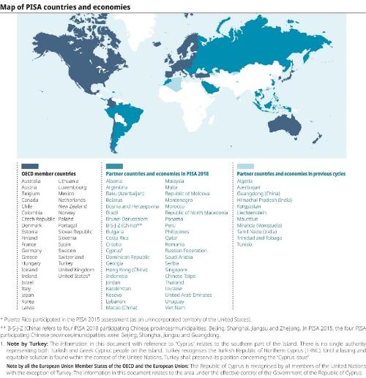
OUR GOAL
We imagine to be a research team hired by the European Commission in order to investigate the level of education throughout the main State members.
The focus of our analysis is:
Compare the education data among the main countries of Europe
Investigate the level of ‘integration’ of immigrant students across different countries and possibly different years
Investigate the relationship between students' results in the PISA test and their mental health
Find the reasons behind the best perfoming educational system

Slide 4
FEATURES OF INTEREST
Here we list some of the most interesting features for our scope:
Wealth indicators
Immigration status
Home and family indicators
Mental Health indicators
School support and resources

Slide 5
METHODOLOGIES
Considering the nature of our dataset and our analysis we intend to use some of the techniques to make analysis across different countries such as:
Anova
Manova
Linear models (for prediction)
Clustering techniques

